Slide 1
DIAS: Decentralized Internet Applications and Services
Final Project Presentation
3/13/14
Adriana Flores
Clayton Shepard
Ellis Giles
Yanda Lu
Haiuhua Shen

Slide 2
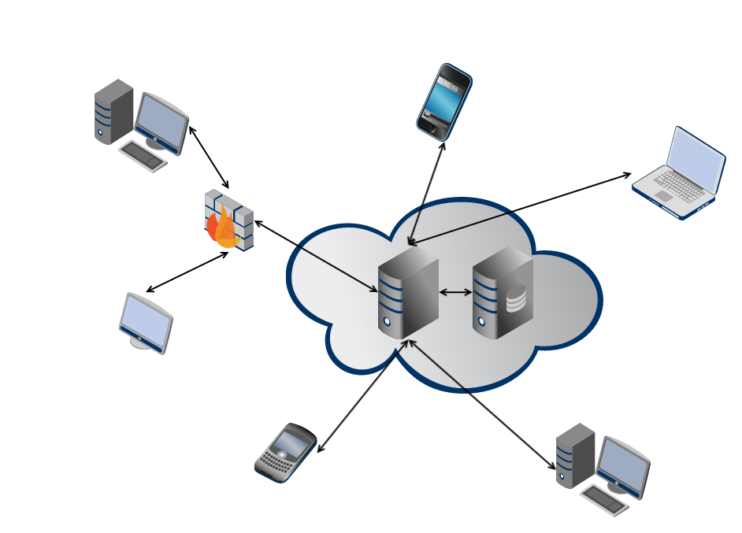
Problem: Centralized Architecture
Single point of failure
Privacy
Security
Control over data
Energy efficiency
Power hungry data centers
Google: 260 million watts [1]
[1] Glanz, James . “Google Details, and Defends, Its Use of Electricity.” The New York Times 8 Sep. 2011
Notes:
. Use 2 minutes to remind audience the problem/question that you want to address
====
centralized servers have many drawbacks, ranging from
privacy, security, and fault-tolerance, to even energy-efficiency and control over data
Power-hungry data centers
According to Google their global data center operation electrical power ranges between 500 and 681 megawatts.
quarter of the output of a nuclear power plant
Decentralize the current server-client mode paradigm in the current Internet

Slide 3
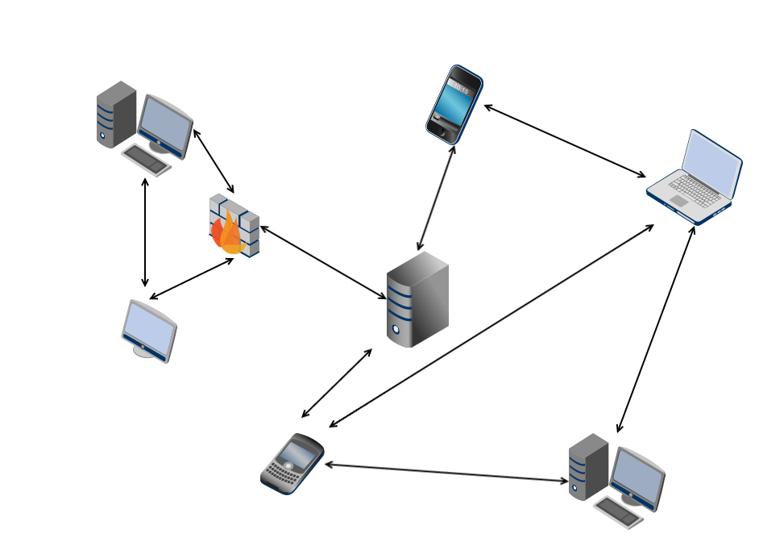
Decentralized Architecture
Robust to failure
Single point of failure
Full ownership and storage of your data
Privacy
Security
Control over data
Self-devices energy consumption
Energy efficiency
Power hungry data centers
Google: 260 million watts [1]
Notes:
. Use 2 minutes to remind audience the problem/question that you want to address
====
centralized servers have many drawbacks, ranging from
privacy, security, and fault-tolerance, to even energy-efficiency and control over data
Power-hungry data centers
According to Google their global data center operation electrical power ranges between 500 and 681 megawatts.
quarter of the output of a nuclear power plant
Decentralize the current server-client mode paradigm in the current Internet

Slide 4
DIAS: Decentralized Internet Applications and Services
Goal:
Decentralize the current server-client model
Replace servers with point to point communication for personal communication and services
Benefits:
Security, Privacy, Resilience, Cost, and Power
Challenges:
Redundancy, Uptime, Failover, Battery Management
Goal:
Decentralize the current server-client model
Replace servers with point to point communication for personal communication and services
Benefits:
Challenges:
Security
Privacy
Resilience
Cost
Power
Redundancy
Uptime
Failover
Battery Management
Notes:
. Use 2 minutes to remind audience the problem/question that you want to address
=========
How do we ensure reachability?
What happens if the cellphone loses connectivity?
What if it is lost/broken/stolen?
We need to find novel methods to ensure redundancy for both uptime and data.
Redundancy
Uptime
Data

Slide 5
DIAS Architecture
DIAS Core
Different Services
Problem:
Roll their own logging
Name resolution
Configuration Files
Saving / Reading Data Files
Different User Interfaces
Solution:
Common Service Interface for Utilization!
Services
Web
App
Email
SSH
Rsync
…
Proxy (SOCKS5)
Command Line Interface
Runs on any Java Enabled Computer
Logging System
DIAS Android
Name Resolver
Runtime Configuration
Tabbed GUI
Start/Stop Services
Logging
Peer-To-Peer
Rice Pastry Network
Battery
Power Analysis
Notes:
. Use 10 minutes to explain in detail your solution or approach to address the problem/question

Slide 6
DIAS Architecture: Threads
DIAS Core
Function | Threads
Web Server | 5 Threads
Application Server | 5 Threads
Email Server | 2 Threads
SSH Server | 2 Threads
Rsync | 1 Thread
Proxy Server | 5 Threads
Name Resolver | 1 Thread
Rice Pastry | 2 Threads
Monitoring | 1 Thread
Control Threads + Async. User & System Events
Services
Web
App
Email
SSH
Rsync
…
Proxy (SOCKS5)
Command Line Interface
Runs on any Java Enabled Computer
Logging System
Name Resolver
Runtime Configuration
Tabbed GUI
Start/Stop Services
Logging
Peer-To-Peer
Rice Pastry Network
Battery Power & Net Monitori
Notes:
. Use 10 minutes to explain in detail your solution or approach to address the problem/question

Slide 7
DIAS Architecture: Node Naming
Suppose I want to run DIAS on my machine
How can others find my node if I need a fully qualified domain name?
Virtual Private Network can provide a central naming authority but becomes a central point of failure – against a decentralized Internet
Dynamic DNS solves some issues such as host IP changing, but hosts can be NAT’d behind firewalls or not available with stale entries.
One solution is provide naming resolution through an overlay network.
Browsers and Applications will cache my node name too, so what happens if I change IP or failover?
DIAS users (or others) can use a service that will lookup names through the overlay network or DNS and not cache names.

Slide 8
DIAS Architecture: Node Naming
Domain Name System – DNS Entry Time-To-Live
Host Caching of Domain Names
OS (Linux, Android, etc.)
Host Machine
Host and Application Level Solutions:
Host Networking Libraries
(usually respect TTL values and cache the DNS entry)
Set a low Time-To-Live (TTL)
Entry in Domain Name System - DNS Records
Java InetAddress Library
(Caches Entry Internally To the Class – Sometimes Indefinitely)
Implement a Java Security Manager
Policy to set to zero the network. address.cache.ttl and .negative.ttl
JVM
Variant
User Application Level Caching
DNS Entries
Set / Configure / Modify Applications to use a Proxy Server

Slide 9
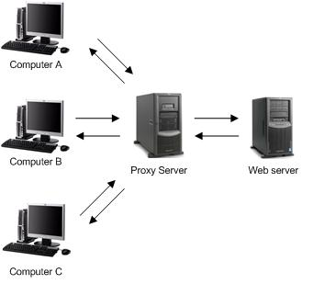
DIAS Architecture: Proxy
Now Embed the Proxy Server as software with DIAS…
Proxy Server
DIAS Android
Runtime Configuration
Tabbed GUI
Start/Stop Services
Logging
Battery
Power Analysis
Utilization of the proxy on localhost server can be problematic.
DIAS Core
Services
Proxy (SOCKS5)

Slide 10
DIAS Architecture: Proxy
Specifying the Proxy Server to localhost on a Wi-Fi Connection on Android doesn’t work.
There’s no bypass rules, so all traffic goes through the localhost proxy.
Thus, when the localhost proxy tries to reach the network, it is proxied itself and eventually crashes.
Specifying a Proxy Server on a cellular connection isn’t recognized.
Google Chrome and Android’s built in Internet browser don’t support user proxy server.
Use Mozilla Firefox or embed a Web browser (Web View and set proxy by Java Reflection into core class provided by Android).

Slide 11

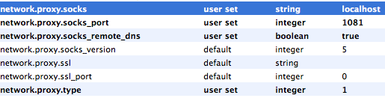
DIAS Architecture: Proxy
Mozilla Firefox has Socks Proxy support built in for both desktops and Android.
Set parameters to use Socks 5.
about:config
Search for proxy:

Slide 12
Domain/Node Name Resolution
Now we have a proxy, so what?
User Application
Configured for DIAS localhost 1081 SOCKS
Connects lh:1081 & Sends
SOCKS: 5
Connect: facebook.com
Name Resolver
Checks Name Cache
If Valid and not expired can return value, else lookup.
Name / IP / Time
Cache (Short TTL)
In Parallel check both DNS and the DIAS overlay, e.g. query node Name & check for return value after timeout.
Regular DNS Query
Query the DIAS Pastry Overlay

Slide 13
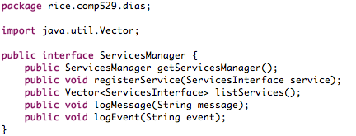
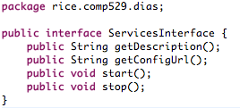


Proxy Jsocks
1081
Other Services
Nano HTTPD
Web
8085
RSync
App
8080
Email
2525
SSH
22

Slide 14

DIAS: Web Server
Nano HTTPD
Small
Single Java File
Embedded Systems
Multi-Threaded – 5 Threads
Port 8085
Modified to conform to Dias Service Interface
Modified to implement Dias Logging Service

Slide 15
ERG Notes:
MAKE SYSTEMS PICTURE recg boot node, etc.
RESULTS,
battery test (someone should run our latest code for 6 hours or so and then do a plot - could even integrate into the plot I did awhile back)
- How we tested failover, slides on the exact setup, what was performed, results, etc. If we configure our browser to use our proxy server then even dns failover works great.
- Email testing. Have to be root to get to port 25 to work, but we sent an email from our phone to gmail, gmail to phone, ..... results… picture etc.
Fwd Work:
Using p2p for transport
- email server running on a different port (so users don't have to root), but email will be routed through dias servers that have 25 open....
P2P for Backup
P.A.S. - Picture, wouldn’t that be cool.
If everyone used DIAS….

Slide 16
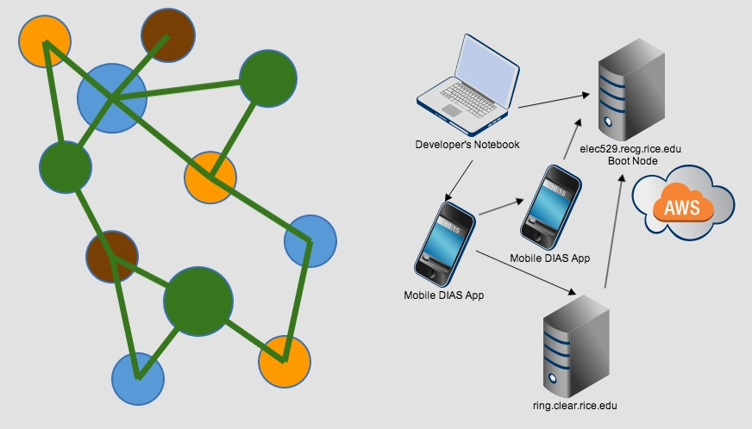

Slide 17
Experiments
Testing of individual services
Jetty, Kirium, etc.
DNS and Proxy Testing
Nano HTTPD Testing
Email Testing
Battery Tests
Galaxy S4 Running DIAS
Two Hour Tests:
Regular Usage 5%
Streaming 2.35 GB Data 28%
DIAS Regular Usage with proxy 10%
Replication: Rsync and SSH Testing

Slide 18
Forward Work
P2P for transport
Could eliminate VPN
Could use peer for browsing service
P2P for replication
Push files to peers not running rsync
Email server running on a different port
Users don't have to have root, but email may be routed through DIAS servers that have 25 open.
DIAS as a Platform-As-A-Service Model.

Slide 19
DIAS: Application and Web Server
Yanda

Slide 20
DIAS Architecture: P2P
Ported to Android.
Rice.environment setup for Android
Removed unsupported Java classes.
Peer-To-Peer
Rice Pastry – Overlay Network

Slide 21
DIAS Implemented Services
Web – Nano and iJetty
Email - JES
SSH
Proxy
P2P
Web
SSH
Email
Proxy
Peer to Peer
Replication

Slide 22
DIAS: Email Server
Adriana

Slide 23
DIAS: SSH Server
Clay

Slide 24
DIAS: Proxy Server
Ellis

Slide 25
DIAS: Peer to Peer
Haihua
Ellis

Slide 26
DIAS: Replication
Clay

Slide 27
DIAS: Android APP
MAIN TAB…
Ellis & adriana

Slide 28
DIAS DEMO
Download of APP in this website:
Set your device name:

Slide 29
DIAS DEMO
Try Web Service:
Try SSH Service

Slide 30
DIAS DEMO
Failover
Recovery

Slide 31
Summary
Take-home points
Lessons learned
Future Directions
Conclusions
Notes:
. Use 3 minutes to summarize take-home points, discuss lessons learned, future directions, and conclusions

